Slide 1
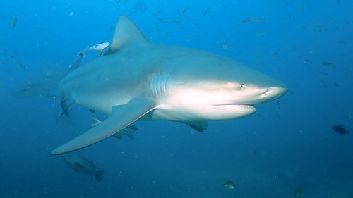
Bull Sharks
By: Archer Googe

Slide 2
Introduction
Not all sharks are dangerous. However, the Bull shark is one that certainly is! They can be found in salt or fresh water all around the world. Bull sharks are always ready to attack. They are very aggressive and often hit their prey with their snout as they are attacking. Bull sharks are interesting animals to look at, but you do not want to get to close!

Slide 3
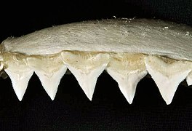
Appearance
Bull sharks can be as long as 11 feet and weigh up to 500 pounds. The females are larger than the males. They have squared off snouts to help attack their prey. They can turn quickly in water with the help of their pointed pectoral fins. Bull sharks have around 350 jagged teeth. Quick turns in water, snout hits, and all of those teeth certainly make the Bull shark fierce!

Slide 4
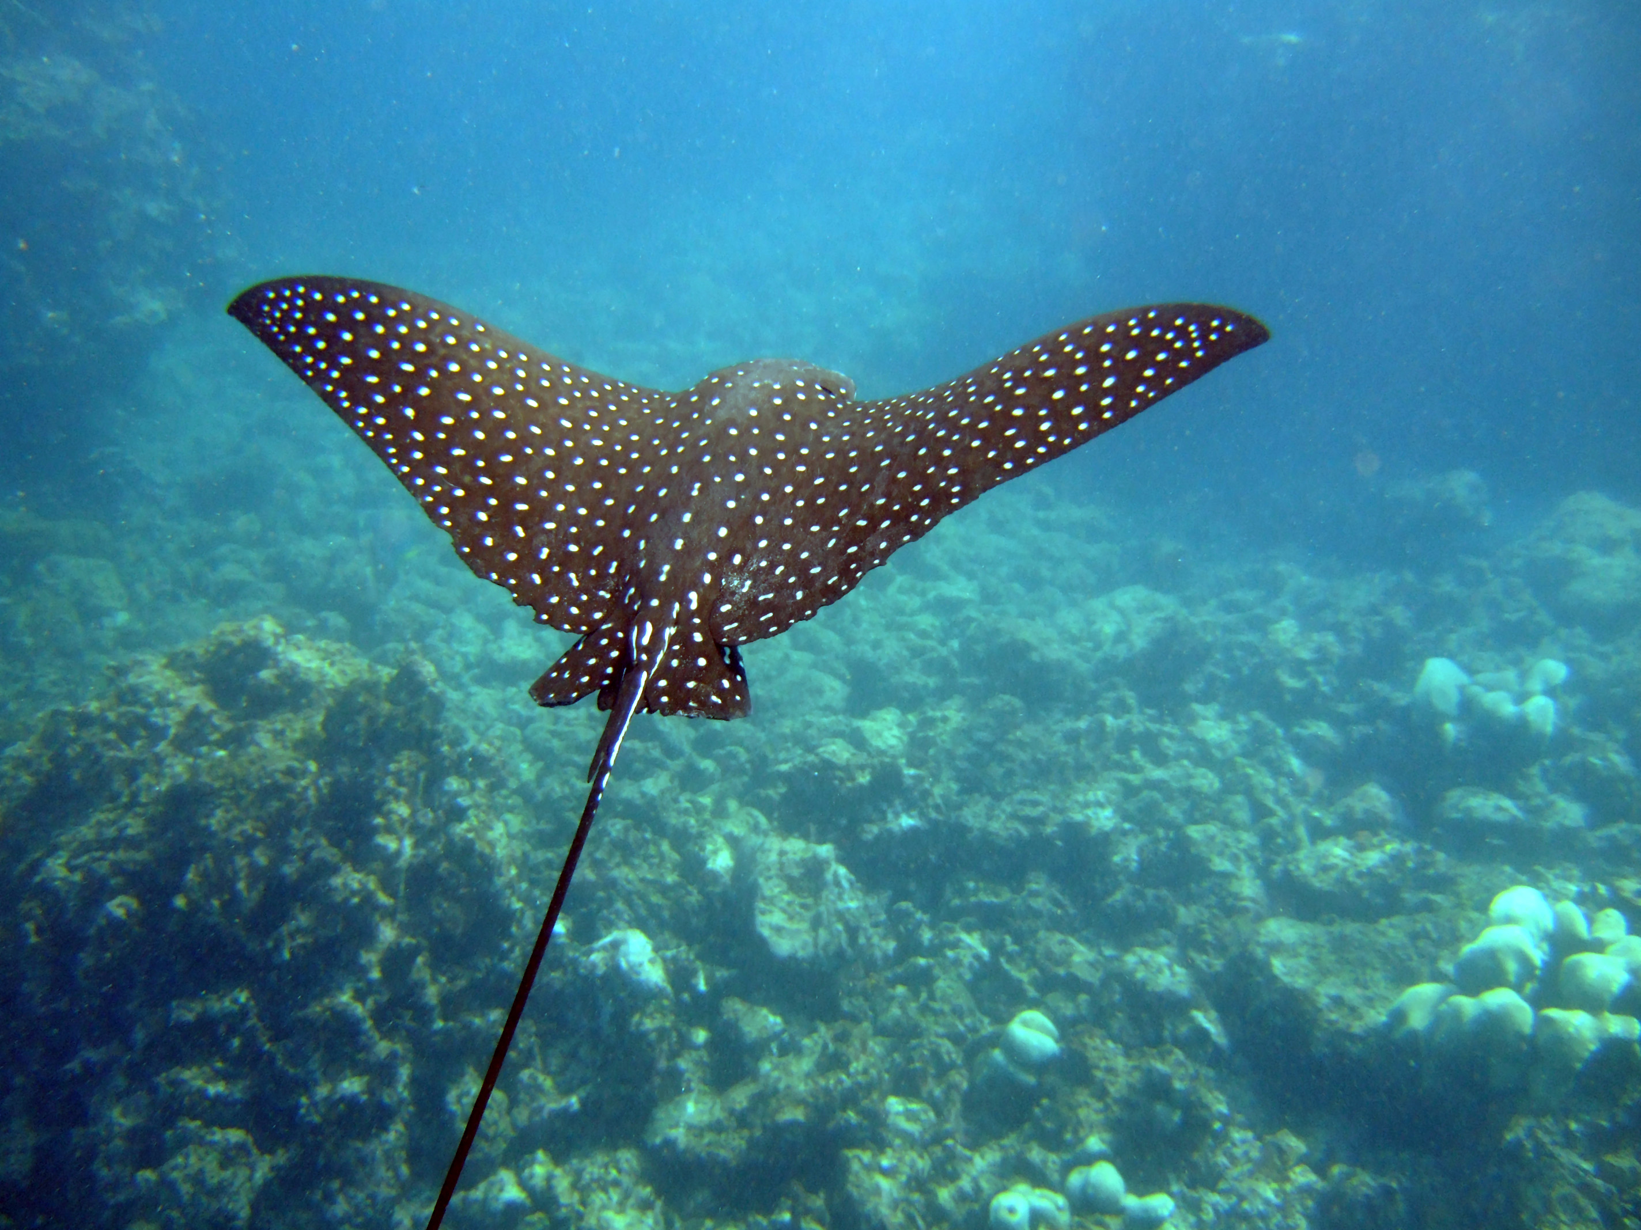
Diet
Bull sharks like to hunt alone. They are carnivores and are known for eating almost anything that can find. Their favorites are bony fish and stingrays. However, they will also eat dolphins, sea turtles, squids, and crabs. They will even eat other sharks. Bull sharks like to hunt in dark, murky waters. They use their strong sense of smell and hearing to find prey.
This Photo by Unknown Author is licensed under CC BY
This Photo by Unknown Author is licensed under CC BY

Slide 5
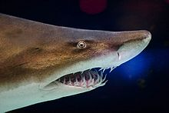
Fun Facts
Bull sharks get their name from their bullish personality. They prefer to swim in warm waters near the coast. Even though they are one of the most dangerous sharks, they are not the fastest. Bull sharks have adapted over millions of years. Shark ancestors lived more than 400 million years ago!
Sharks are very interesting creatures. It is important to learn about them in order to protect ourselves when we are enjoying their habitat.

